Slide 1
Additional HTML Tags

Slide 2
Internal Linking
The a tag can be used to link to another section of the same document by specifying the element’s id as the link’s href.
To link internally to an element with its id attribute set, use the syntax #id.

Slide 3
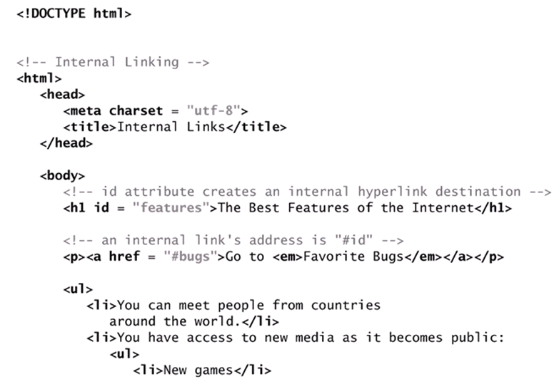
Example

Slide 4
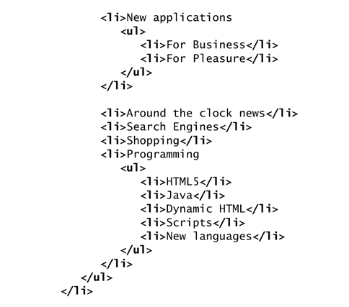
Example(Conts)

Slide 5
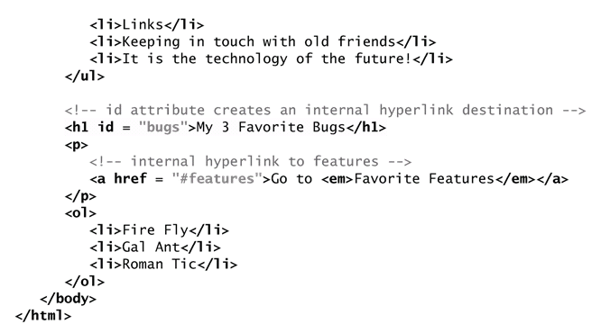
Example(Conts)

Slide 6
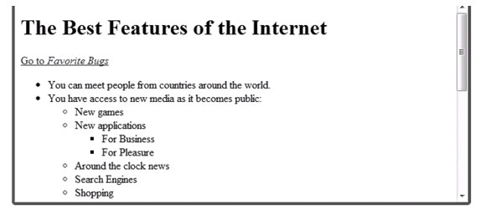
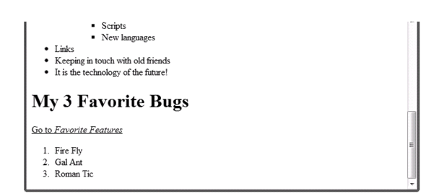
Example(Conts)

Slide 7
Page-Structure Elements
HTML5 introduces several new page-structure elements that meaningfully identify areas of the page as headers, footers, articles, navigation areas, asides, figures and more.
It should be pointed out that none of these new tags are required or mandatory in HTML5.
They can help improving the semantics of your web pages/website.
You may decide to use only one or a few of these tags in your pages, or maybe none. Without, your page will still validate fine as HTML5.
The next example shows those areas

Slide 8
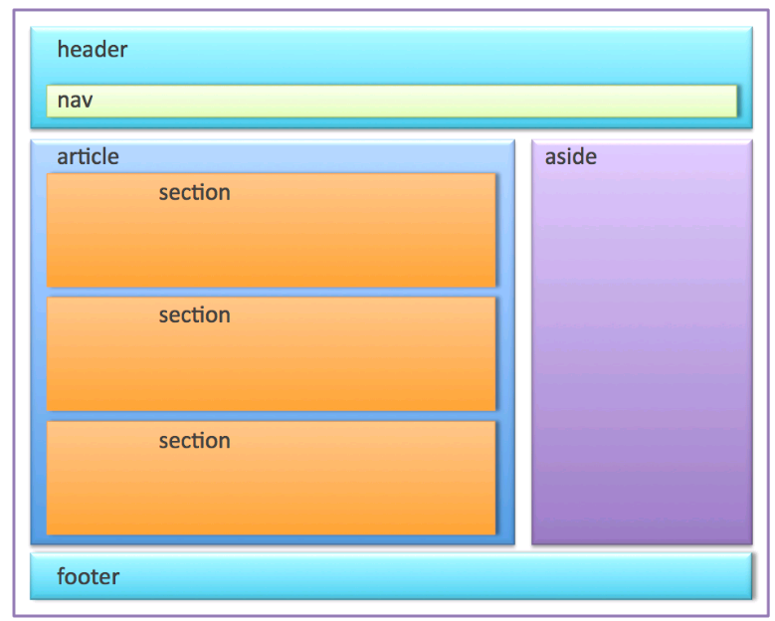
Page-Structure Elements(Conts)

Slide 9
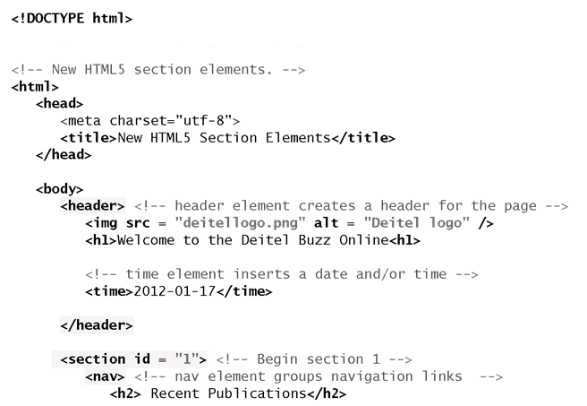
Example

Slide 10
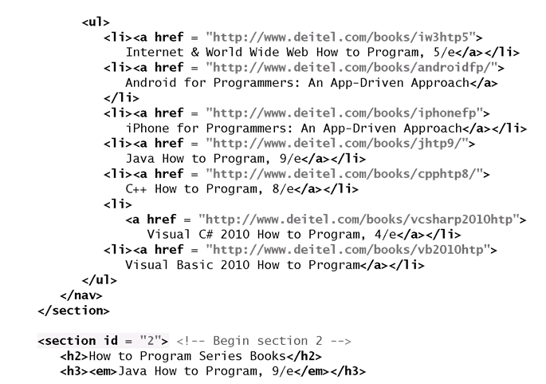
Example(Conts)

Slide 11
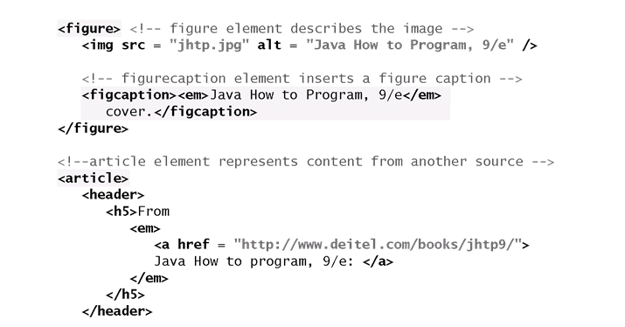
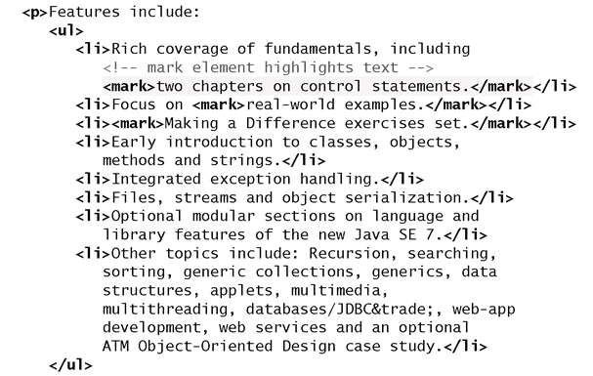
Example(Conts)

Slide 12
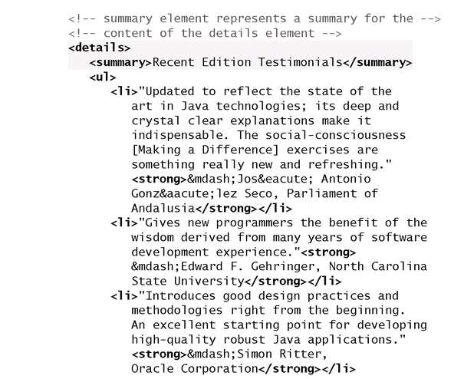
Example(Conts)

Slide 13
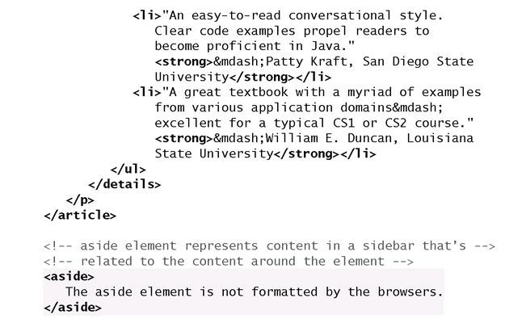
Example(Conts)

Slide 14
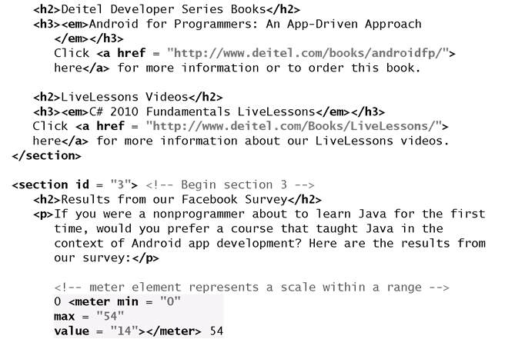
Example(Conts)

Slide 15
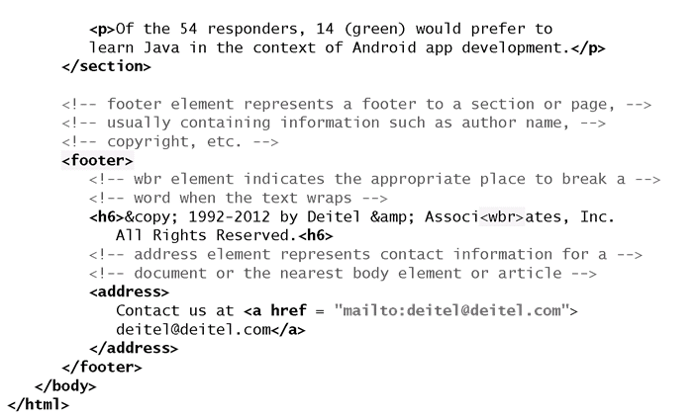
Example(Conts)

Slide 16
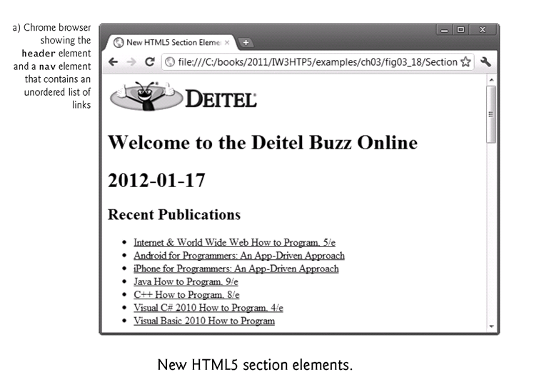
Example(Conts)

Slide 17
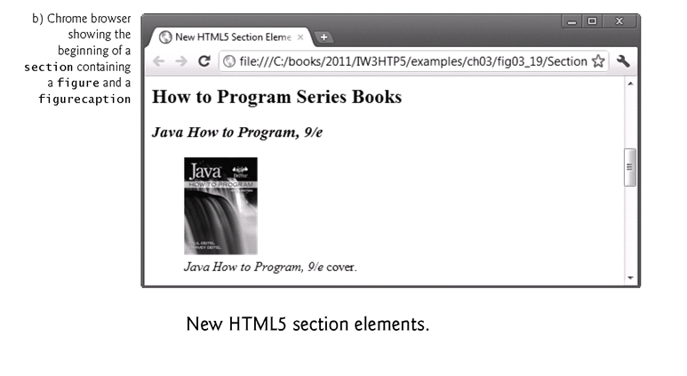
Example(Conts)

Slide 18
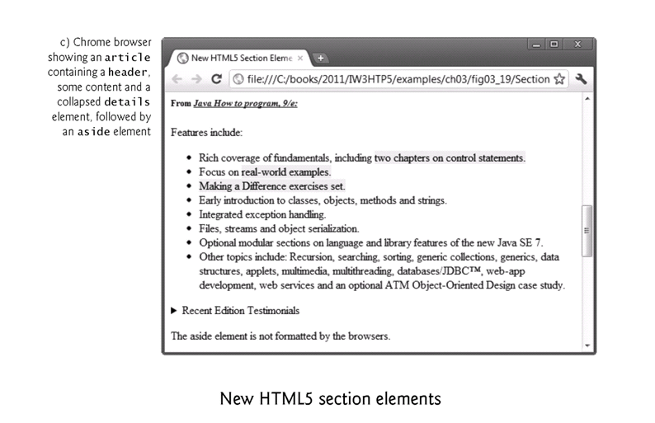
Example(Conts)

Slide 19
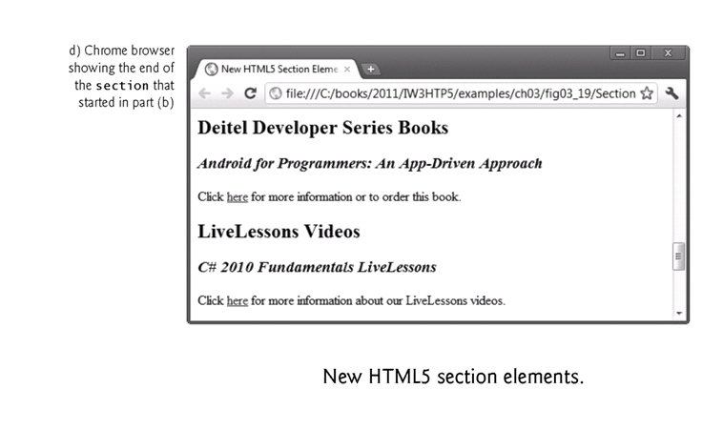
Example(Conts)

Slide 20
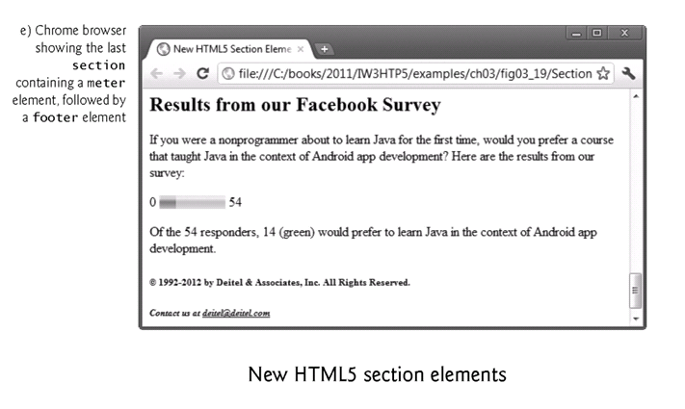
Example(Conts)

Slide 21
header Element
The header element creates a header for this page that contains both text and graphics.
The header element can be used multiple times on a page and can include HTML headings (<h1> through <h6>), navigation, images and logos and more.
time Element
The time element, which does not need to be enclosed in a header, enables you to identify a date (as we do here), a time or both.

Slide 22
nav Element
The nav element groups navigation links.
In this example, we used the heading Recent Publications and created a ul element with seven li elements that link to the corresponding web pages for each book.

Slide 23
figure Element and figcaption Element
The figure element describes a figure (such as an image, chart or table) in the document so that it could be moved to the side of the page or to another page.
The figcaption element provides a caption for the image in the figure element.

Slide 24
article Element
The article element describes standalone content that could potentially be used or distributed elsewhere, such as a news article, forum post or blog entry.
You can nest article elements. For example, you might have reader comments about a magazine nested as an article within the magazine article.

Slide 25
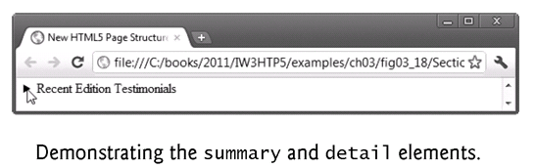
summary Element and details Element
The summary element displays a right-pointing arrow next to a summary or caption when the document is rendered in a browser as shown in next figure.
When clicked, the arrow points downward and reveals the content in the details element.

Slide 26
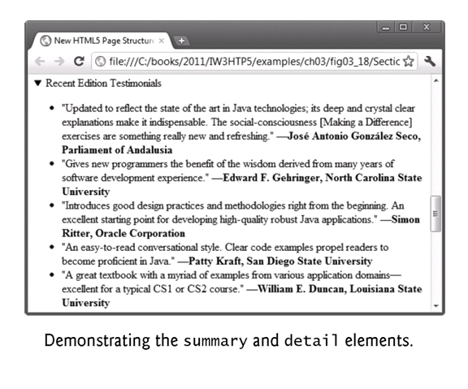
summary Element and details Element(Conts)

Slide 27
section Element
The section element describes a section of a document, usually with a heading for each section—these elements can be nested.
In this example, we broke the document into three sections—the first is Recent Publications.
The section element may also be nested in an article.

Slide 28
aside Element
The aside element describes content that’s related to the surrounding content (such as an article) but is somewhat separate from the flow of the text.
For example, an aside in a news story might include some background history.
The aside element represents a section of a page that consists of content that is tangentially related to the content around the aside element, and which could be considered separate from that content. Such sections are often represented as sidebars in printed typography.
The element can be used for typographical effects like pull quotes or sidebars, for advertising, for groups of nav elements, and for other content that is considered separate from the main content of the page

Slide 29
meter Element
The meter element renders a visual representation of a measure within a range as shown in next figure
In this example, we show the results of a recent web survey we did.
The min attribute is "0" and a max attribute is "54" —indicating the total number of responses to our survey.
The value attribute is "14", representing the total number of people who responded “yes” to our survey question.

Slide 30
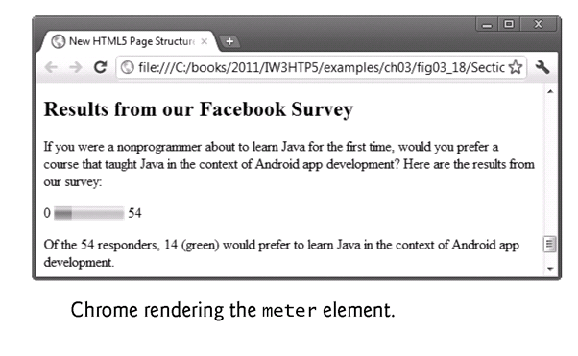
meter Element(Conts)

Slide 31
footer Element
The footer element describes a footer—content that usually appears at the bottom of the content or section element.
In this example, we use the footer to describe the copyright notice and contact information.

Slide 32
Text-Level Semantics: mark Element and wbr Element
The mark element highlights the text that’s enclosed in the element.
<mark> </mark>
The wbr element indicates the appropriate place to break a word when the text wraps to multiple lines.
<wbr />
You might use wbr to prevent a word from breaking in an awkward place.

Slide 33
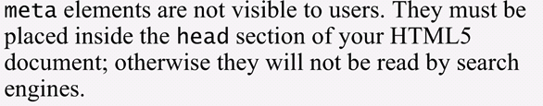
Meta Elements
One way that search engines catalog pages is by reading the meta element’s contents.
The name attribute identifies the type of meta element
The content attribute
Of a keywords meta element: provides search engines with a list of words that describe a page, which are compared with words in search requests
Of a description meta element: provides a three- to four-line description of a site in sentence form, used by search engines to catalog your site. This text is sometimes displayed as part of the search result

Slide 34
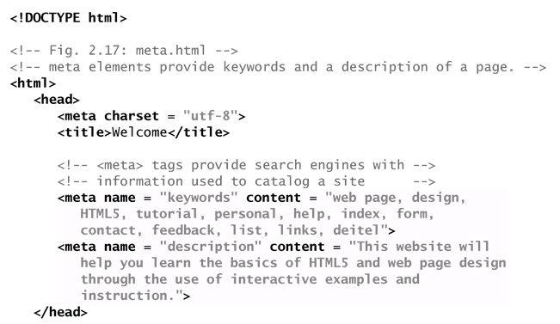
Example

Slide 35
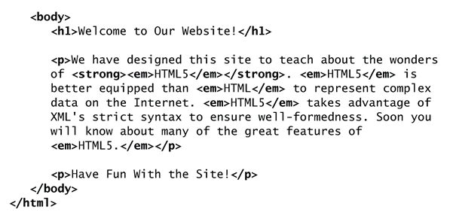
Example(Conts)

Slide 36
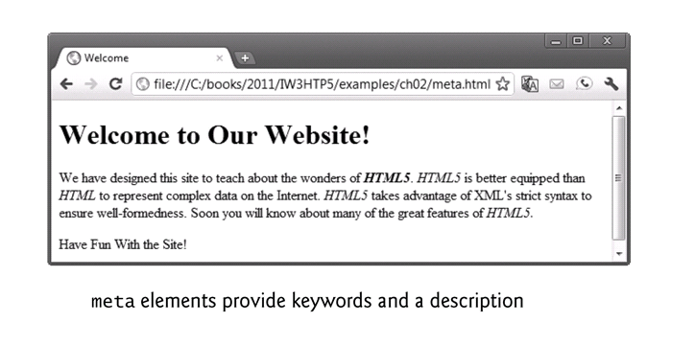
Example(Conts)

Slide 37
HTML Iframes
An HTML iframe is used to display a web page within a web page.
The iframe in HTML stands for Inline Frame. The ” iframe ” tag defines a rectangular region within the document in which the browser can display a separate document, including scrollbars and borders. An inline frame is used to embed another document within the current HTML document.
Syntax
<iframe src="url" title="description">
Tip: It is a good practice to always include a title attribute for the <iframe>. This is used by screen readers to read out what the content of the iframe is.
The ‘ src ‘ attribute is used to specify the URL of the document that occupies the iframe.

Slide 38
Iframe - Set Height and Width
Use the height and width attributes to specify the size of the iframe.
The attribute values are specified in pixels by default, but they can also be specified in percentage like ” 80% “.
Example
<iframe src="demo_iframe.htm" height="200" width="300" title="Iframe Example"></iframe>

Slide 39
The Difference Between Frames and Iframes
When you use frameset you split the visual real estate of a browser window into multiple frames.
Each frame has it’s own contents and the content in one don’t spill into the next.
An iframe, on the other hand, embeds a frame directly inline with the other elements of a webpage.
While both frames and iframes perform a similar function – embedding a resource into a webpage – they are fundamentally different.
Frames are layout-defining elements.
Iframes are a content-adding elements.

Slide 40
The Problem with Frames
Usability challenges: With the rise in popularity of mobile devices and tablets with small displays it’s more important than ever that websites offer multiple views which change based on the size of the device viewport. While frames can be manipulated to provide a certain degree of responsiveness, they are simply not well-suited to creating responsive websites.
Accessibility challenges: Screen readers and other assistive technologies have a very hard time understanding and communicating websites that use frames.
In addition to the accessibility and usability issues created by frames, the trend within web design is to separate the content of a webpage from its presentation.
Content should be added and defined by markup such as HTML.
Presentation should be manipulated with languages like CSS and JavaScript.
Using frames is primarily about creating a specific look and layout, a presentation task that should really be handled with CSS.

